Slide 1




COMPUTER
GRAPHICS SOCIETY
WebX Selection Tasks
2026 -27
PAGE 01

Slide 2



Task 3
Automated Timetable Reminder
CREATED BY
PREETAM KUMAR HIREMANI
DEPARTMENT :
INDUSTRIAL AND SYSTEMS ENGINEERING
ROLL NO. : 26IM10059
HALL : LBS
CONTACT DETAILS : preetamkhiremani@gmail.com
PAGE 02

Slide 3

gmail id :
Gmail account
testcgs123@gmail.com
Details
Main password
AND
App-Password
IF FOR TESTING IT REQUIRED THEN PLEASE ASK ME
PAGE 03

Slide 4
Walk-Through tells what is there in those paths and gives overall what I have made in this task.
This part explains the follow
The purpose of making this presentation is to sow what I have done to make this task complete please go through.
Walk-Through
Content
pg no. 8
How I begin the process
What was the reason for making separate road
Problems I encountered and solutions found in the main way or in that specific road.....
Road 1
of Task
Road 2
pg no. 11
pg no. 13
Road 3
PAGE 04

Slide 5
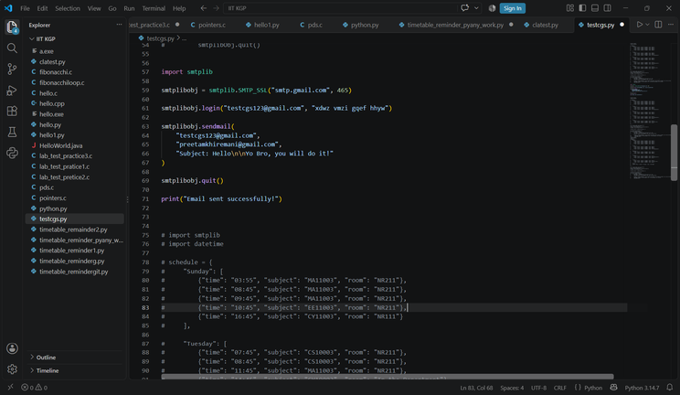
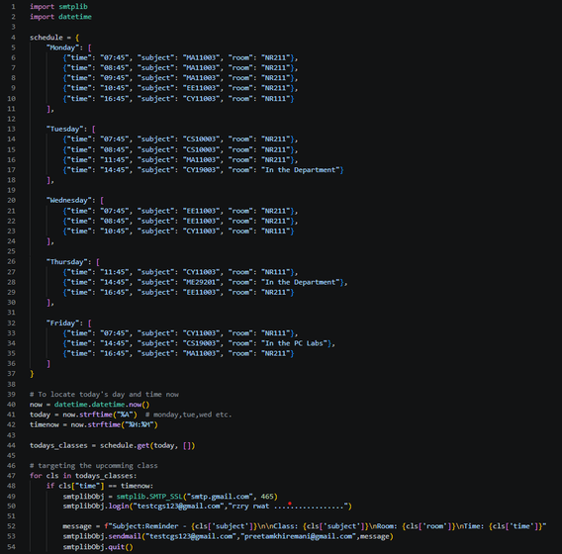
Task
walk-through
fig. a
Created a dummy Gmail + App Password
I first created a gmail account “testcgs@gmail.com” and took help of this video https://www.youtube.com/watch?v=m6tDfvHF3B8 to set app password when I competed the first part of the task.
Problems while signing in: If u set app password then you encounter many things while signing in that is as u enter your password to login u need to go to to g.co/sc to get the security code.
Working on code for part 1 of the Task
I worked on python code which could send email with smtplib. Wrote my own class timetable in the code and run the code. This was my fist code fig.1(without docket)
Problems : port 465 works with SMTP_SSL( ) but I was using SMTP( ) and starttls( ) which works with Port 587 since with the port 586 is not simple (need ehlo() etc) so ... I went with 465.
Code with schedule
fig 2 was the scheduled code and having all the updates of checking time and matching it with current timing and sending the mail if match found
Problems : even before this 24hr system was issue U can’t tell 06:00AM and 06:00PM we need need to say it as 06:00 and 18:00 respectively.
fig. b
PAGE 05

Slide 6
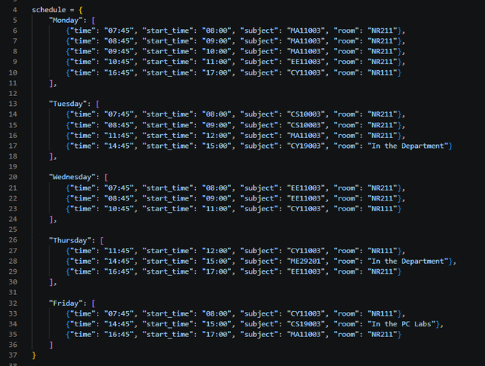

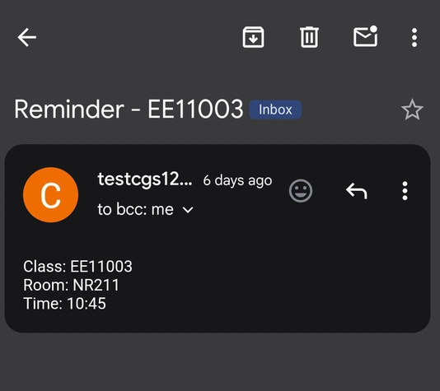
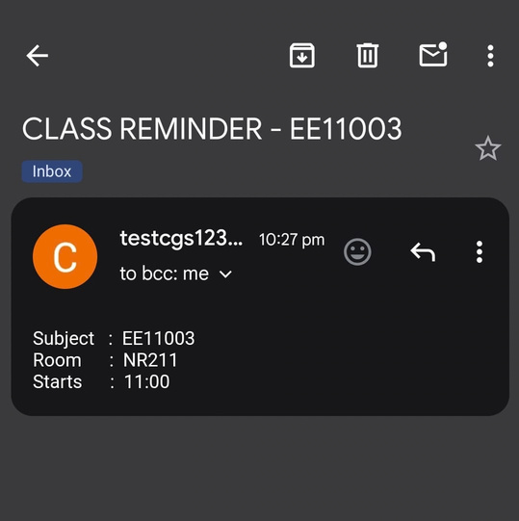

While working for Part 2 : PythonAnywhere
PythonAnywhere is not for free
PythonAnywhere's free tier only allows a scheduled task to run once per day, not every few minutes (that frequent scheduling is a paid-only feature there). So with our script , even with a task set up, we only catch one class on a lucky day when the single daily run happened to land on an exact class time — every other class that day would get no email at all.
while working I found that this my current script sends the mail as fig 3 so I changed the schedule format as fig 4. and the message line in the script also changed, from
message = f"Subject:Reminder - {cls['subject']}\n\nClass: {cls['subject']}\nRoom: {cls['room']}\nTime: {cls['time']}"
to
message = f"Subject:CLASS REMINDER - {cls['subject']}\n\nSubject : {cls['subject']}\nRoom : {cls['room']}\nStarts : {cls['start_time']}"
This was done because pythonanywhere runs our script runs top to bottom and exits. It sends an email only if you happen to run it in the exact minute that matches a "time" entry (e.g. exactly 07:45). Otherwise it does nothing and this thing also happened in other way also( in road 3 ).
check fig 4
It checks checks the “time” (15min before) and give output as
fig. c
PAGE 06

Slide 7
since
PythonAnywhere
Is not for free I have 3 ways
Road 1
Road 2
Road 3
It was for working on python anywhere and code and the details of login are provided I could not tes
It works on the Python anywhere only and sends the timetable of todays day it contains full information of the classes today the person have
It works on git hub and sends the class details around 10-15 minutes before the class on this way we will see there are still many thing need to be sorted.
pg no. 8
pg no. 11
pg no. 13
PAGE 07

Slide 8
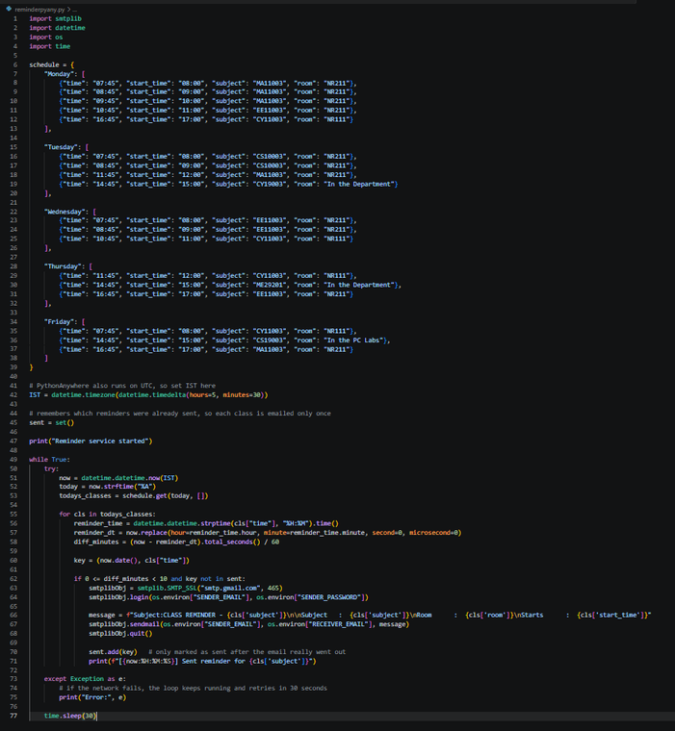
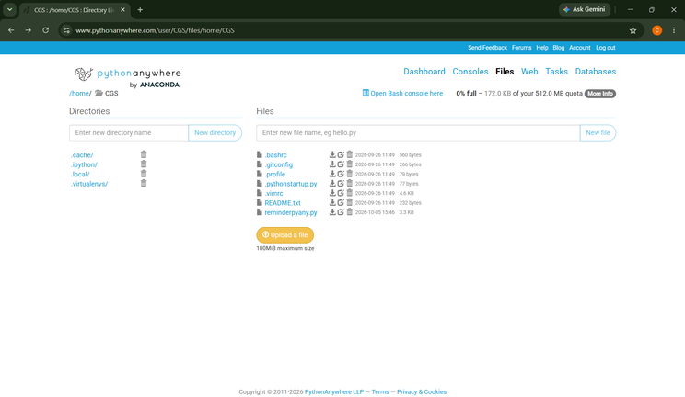
ROAD
Since I was not having paid version on python anywhere so I could not test many times whether the code works on python anywhere or not.
Problem : Python also uses UTC as reference so code was to be set for IST.
so final script is like fig6
1
Runs on PythonAnywhere paid
Login Details in pythonanywhere
email id.:- testcgs123@gmail.com
pass.:- Test@123456789
fig. 1
name of the file is
reminderpyany.py
PAGE 08

Slide 9
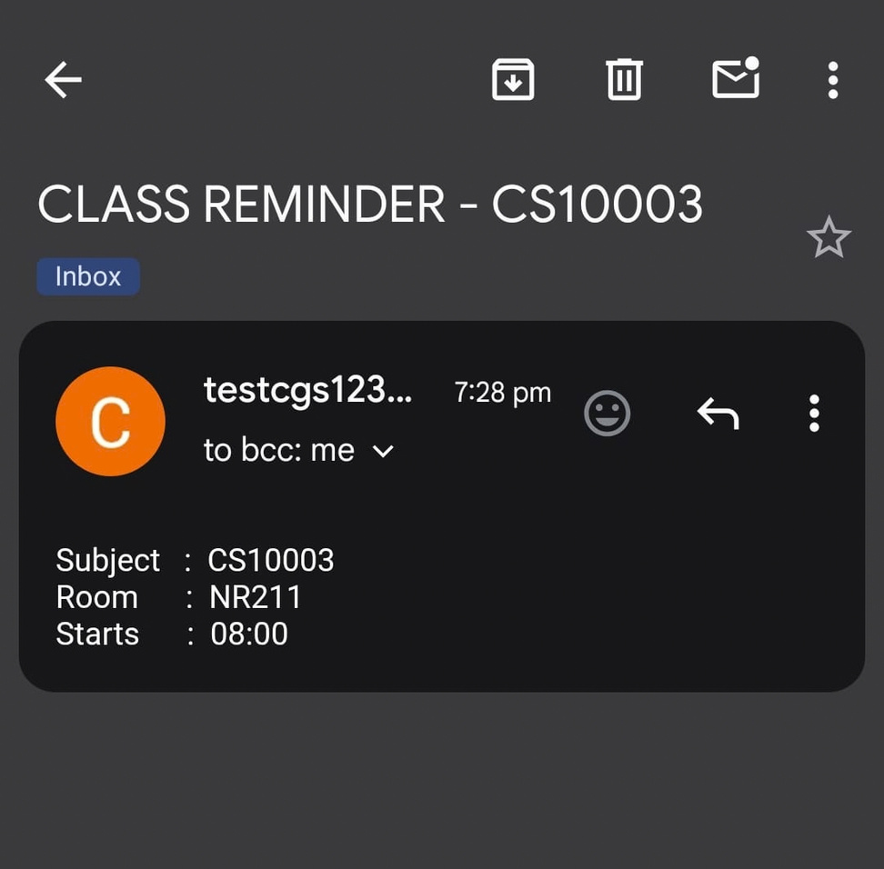
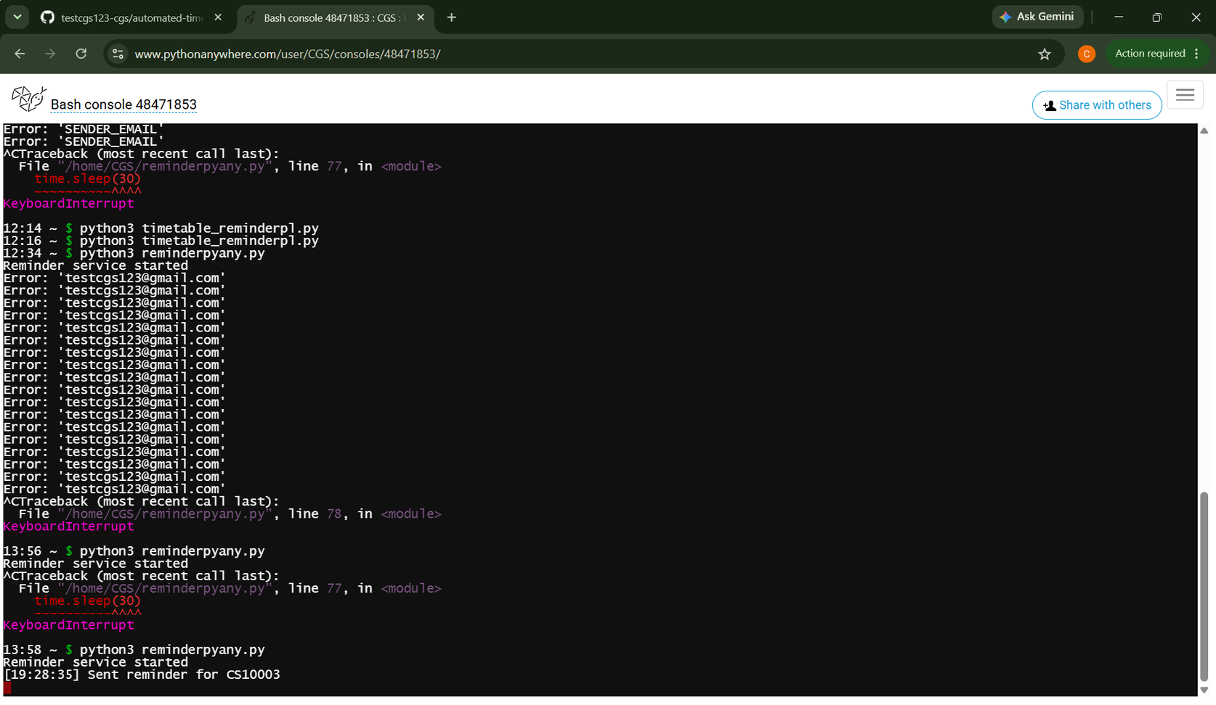
Script
Test
It works 100% but not everytime
PAGE 09

Slide 10
Problem with
PythonAnywhere
Paid
solution
It is not completely free so many things we can’t do there even running the code there is also restricted so I was not able to do many test there
our original script checked for an exact time match (cls["time"] == current_time) for each class individually — Physics at 07:45, Chemistry at 08:45, and so on — assuming the script would run every few minutes to catch each one. But PythonAnywhere's free tier only allows a scheduled task to run once per day, not every few minutes (that frequent scheduling is a paid-only feature there). So in our case, even with a task set up, we’ll only ever catch one class on a day when the single daily run happened to land on an exact class time — every other class that day would get no email at all.
Restructure the script so it doesn't wait for each class's exact moment. Instead, once a day (e.g. early morning), it loops through all of that day's classes and sends one email listing the entire day's timetable — times, subjects, and rooms together. That is the only solution to work with python anywhere ,which is ROAD 2 —
PAGE 10

Slide 11
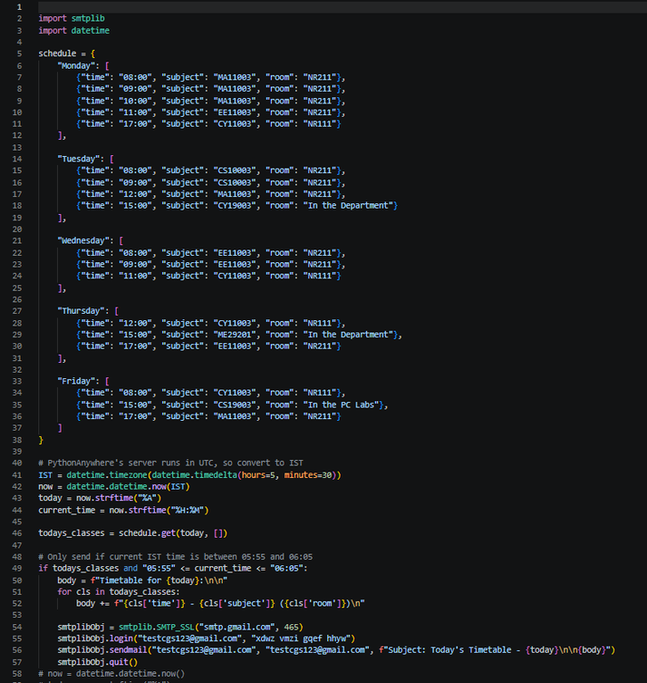
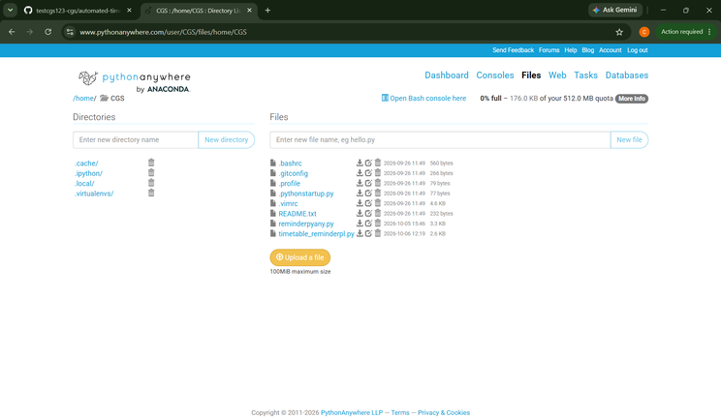
ROAD
This ROAD will send us the email in very simple way that is it will send the mail early morning 6AM and the email contains all the details of todays class.
Reason for choosing this road are on pg no. 12
but truly speaking we can’t even work in this free mode also if you have paid then only it works properly........
2
Runs on PythonAnywhere Free
Login Details in pythonanywhere
email :- testcgs123@gmail.com
pass.:- Test@123456789
fig. 2
name of the file is
timetable_reminderpl.py
PAGE 11

Slide 12
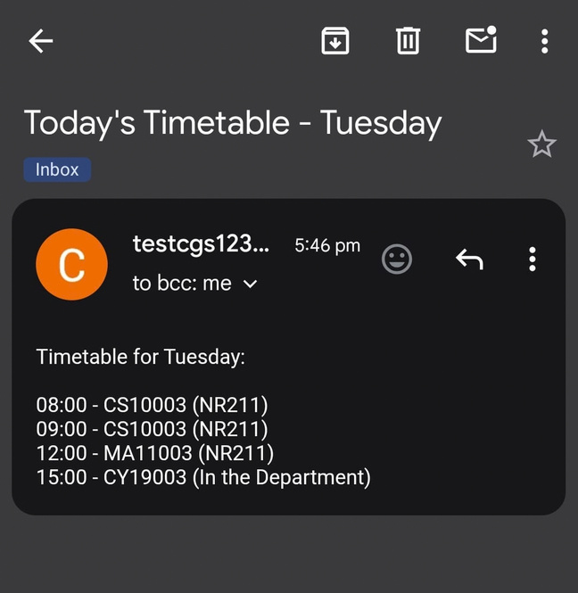
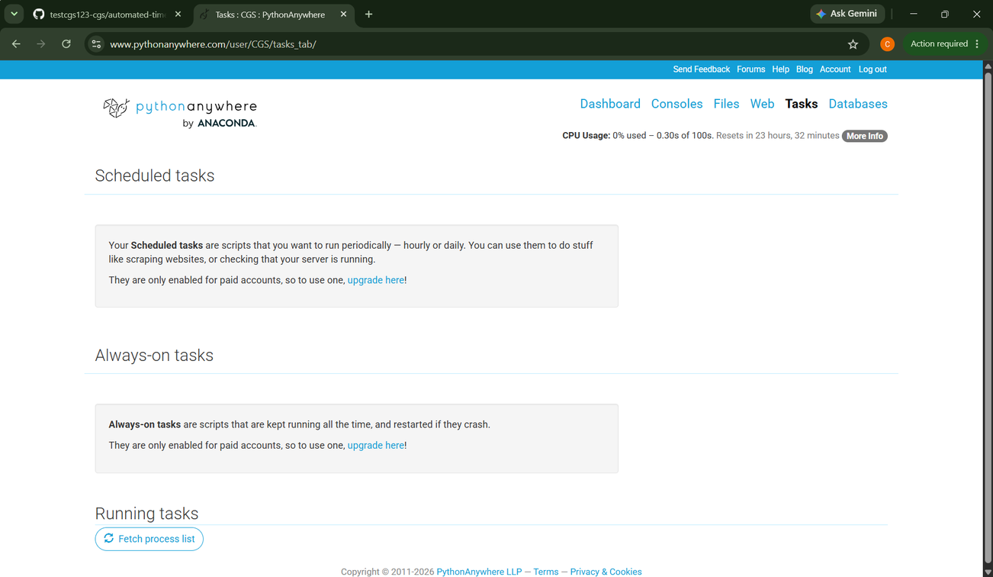
Problems
BUT CODE WORKS
occurred
I the free account also we cant run our code
“Scheduled tasks … are only enabled for paid accounts”
we can not run our code even daily.
we can’t run time to time
we can’t run once a day
nothing we can do in free account so we have github as our best solution
When I run manually
PAGE 12

Slide 13
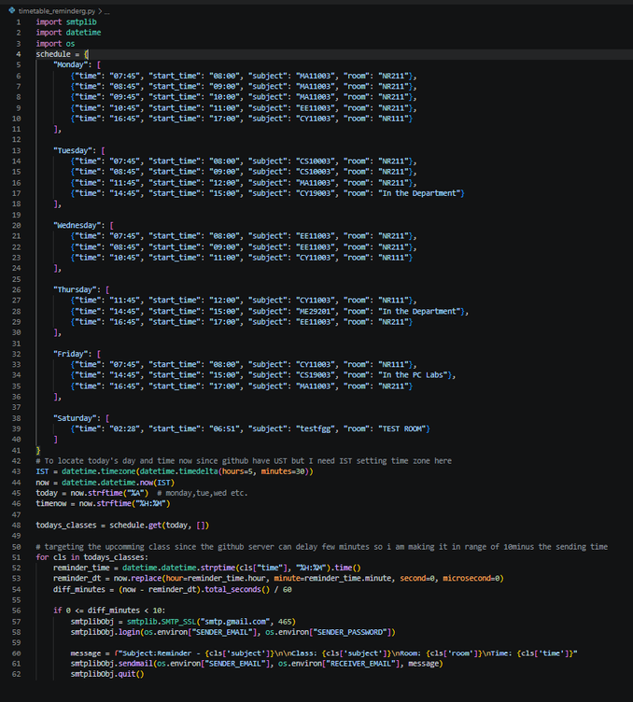
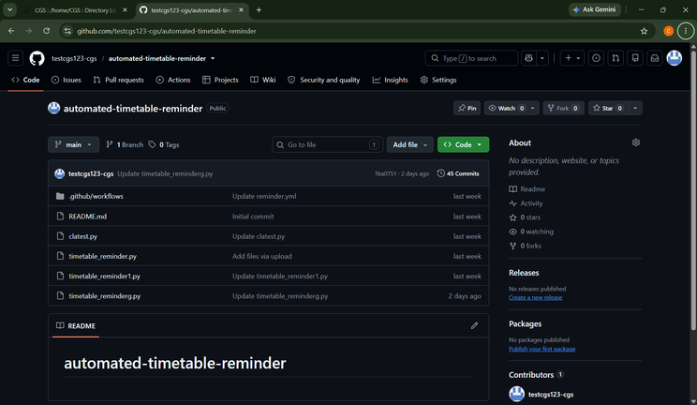
This is the ultimate legal solution I found to run the script.
But it also has problems I have tracked it. we will see that in the next session
Other Problems : The script used datetime.datetime.now() with no timezone. On GitHub's servers this returns UTC, not IST — so 07:45 in our schedule was being compared against UTC time, a 5.5 hour mismatch, and never matched.
Solution: Built an explicit IST timezone object (UTC+5:30) and used datetime.datetime.now(IST) so the script always computes the correct local time regardless of the server's own clock.
ROAD
3
Runs on Github Actions
github sign in details
email : testcgs123@gmail.com
pass : PLEASE ASK IF NEEDED
fig. 3.1
name of the file is
timetable_reminderg.py
PAGE 13

Slide 14
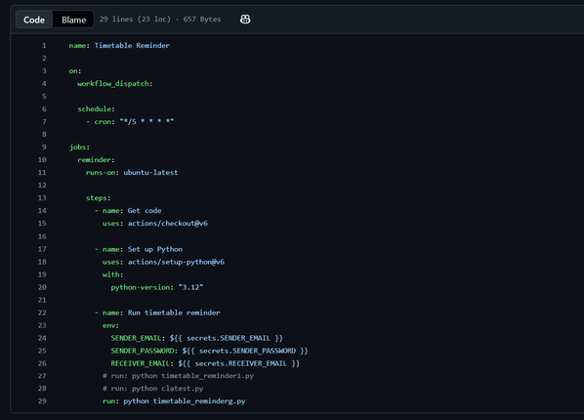
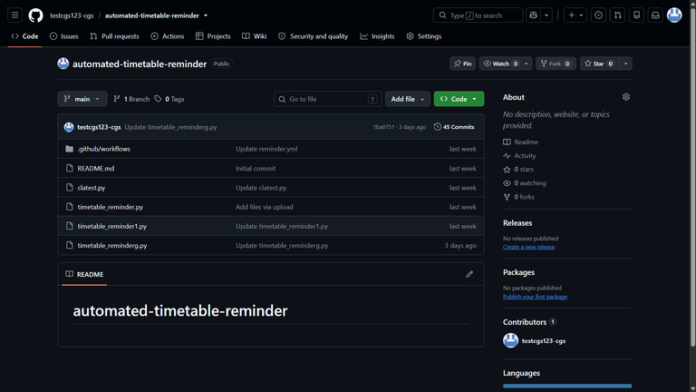
How I
Worked
choosing github
now after pythonanywhere Github was only the solution.
so logged in to github took help from Claude and chatgpt to fix the errors I faced in the on-going step.
fig. 3.2
How I run the code in github
first after completing all my script ready
I came to know
changes made: -
Then after I run the code many time till now it worked 700+ times and sent me email of the classes.
As I said it is not working as we need we only have PythonAnywhere paid one as our best option to have a satisfactory results.
but still u can see the progress in pg no _
Github also uses UTC not IST
  I had to import os module in my code
  github not works for exactly after every 5min as workflow was, see fig 3.2
  and also see the track record for proof.
  we can’t show apppass in code for security purposes so I stored them in
  >Setting > Secret and variables > Action and saved emails and Pass secret
PAGE 14

Slide 15
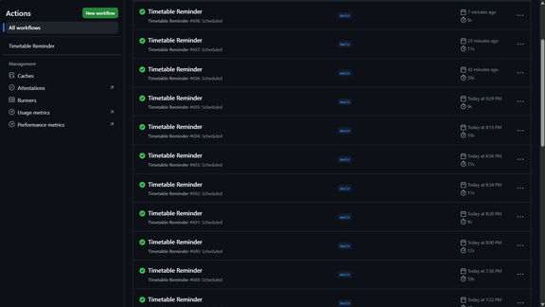
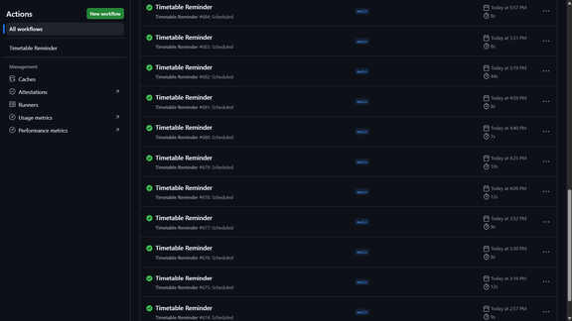
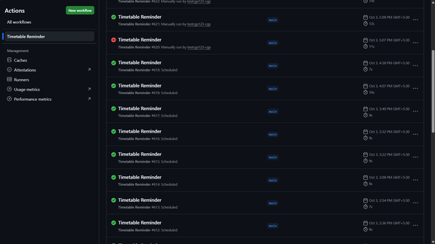
github track
record
fig3.11
fig3.12
figg3.14
we can see sometime we have lag of more that 20min which if occurs and our email sending point belongs to that interval then we will miss that class this also one drawback
PAGE 15

Slide 16
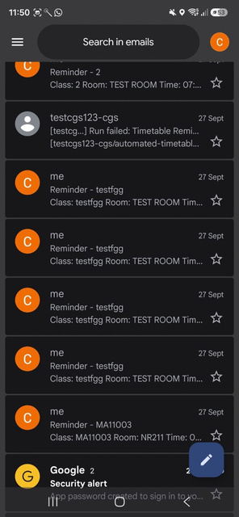
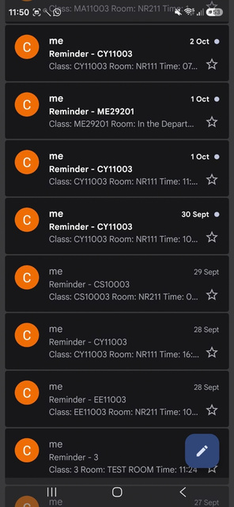
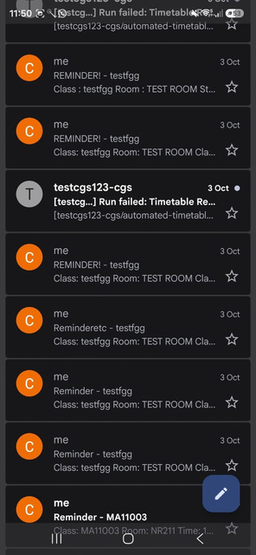
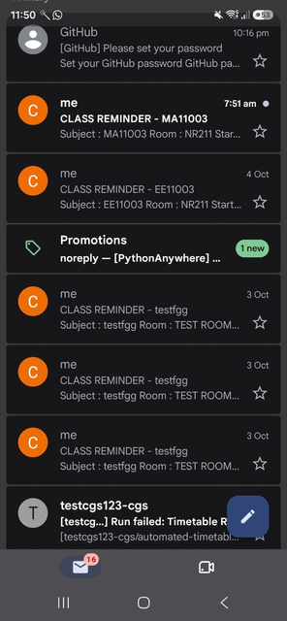
Progress
fig3.11
fig3.12
fig3.13
fig3.14
PAGE 16

Slide 17
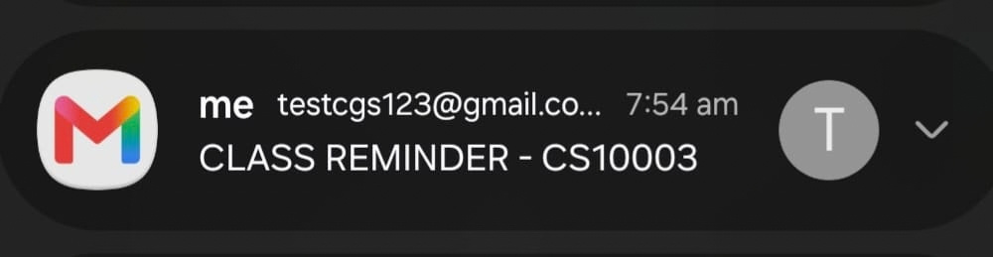
FINAL
CONCLUSION
PythonAnywhere
Did not worked at all for even paid version so we are more depended on github only now
GitHub
I had class at 08:00 but the mail came at 7:54
but I can’t reach Nalanda at time
Because our github delays to send the mail by around 11min sometime gap of 20 min so we can't on time
solution for this issue is
20-25 min earlier we can send the email as I have recorded 20min was the max gap (as per my analysis). So like if we have class at 8:00 then we will keep all "time" variables = "7:35" (45-35) insted of “7:45” etc then send the email this will be little more safe with this code
Git hub worked as we demanded and I have tracked the record and found many loops in that also and gave solutions for that also .
So we have this road as our best option and gave us the result as we can see in track record
PAGE 17

Slide 18

Thank
You.
BY PREETAM KUMAR HIREMANI
26IM10059
preetamkhiremani@gmail.com

